Slide 1
Business opportunity in New York
Hoang Do’s report
April 2020

Slide 2
Business Problem

Slide 3
Business Problem
Business interest
What is the most interested service in New York?
Which areas (neighborhoods) in New York are in short of this service?
Resolution
Collect data about neighborhoods in New York
Collect data about venues of these neighborhoods
Find the most interested venue category
Find cluster of neighborhoods having no the most interested venue category

Slide 4
Data and Methodology

Slide 5
Data and Methodology
Process data about neighborhoods in New York
Process data about venues of these neighborhoods
Find the most interested venue category (the service is most interested in New York)
Analyze the data to find neighborhoods (areas) having no the most interested venue category

Slide 6
1. neighborhoods in New York
Data about neighborhoods in New York can be collected from official online sources such as https://cocl.us/new_york_dataset
The neighborhood data includes critical information such as names, latitude and longitude
The neighborhood data has 306 unique neighborhoods belonging to 5 unique boroughs

Slide 7
2. venues of new york neighborhoods
Data about venues are collected from source of Foursquare
The venue data must show the interested rate of each venue category of a particular neighborhood
The venue data has 20,673 venues belonging to 480 venue categories

Slide 8
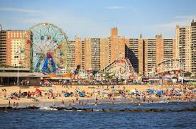
3. the most interested service in New York
The venue category having maximum rate of occurrence frequency
The most interested service in New York is Beach

Slide 9
4. Potential areas for investment in new york
Neighborhoods are clustered based on their similarity of venues
The cluster with the rate (of the most interested venue category) equal zero includes:
Port Ivory
Arlington

Slide 10
Conclusion

Slide 11
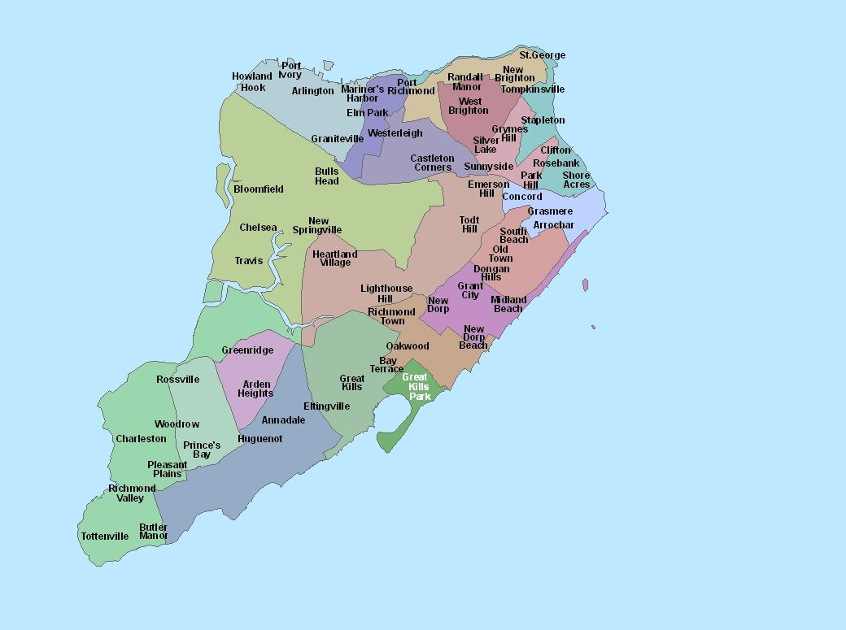
Potential neighborhoods
Port Ivory, Staten Island
Arlington, Staten Island

Slide 12
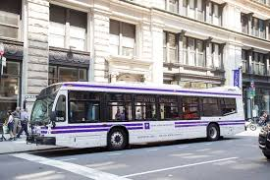
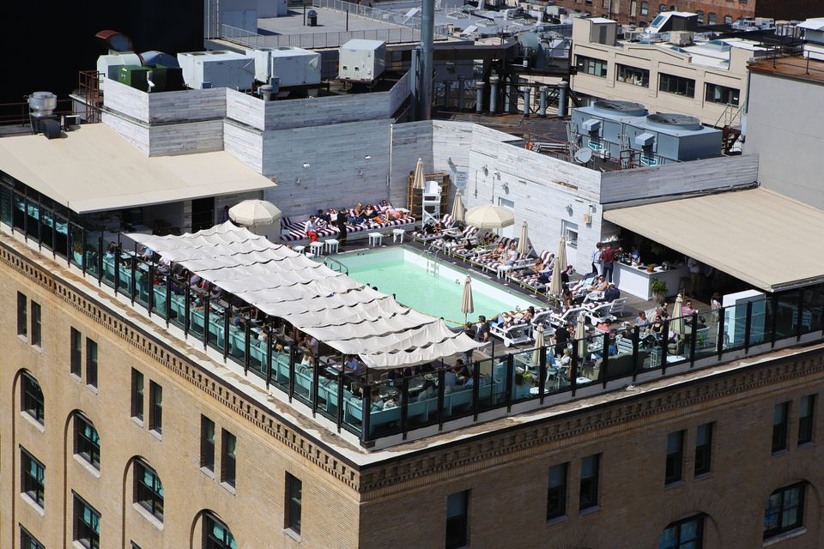
Business opportunities
Shuttle bus from neighborhood center or big hotels to interesting beaches
Swimming pools or restaurants on top of buildings have view toward beautiful beaches

